Slide 1

Python Session 2
Nabajyoti Pathak

Slide 2
Content
Matplotlib Basics
Seaborn Basics

Slide 3
NumPy - Matplotlib
Matplotlib is a plotting library for Python.
It is used along with NumPy to provide an environment that is an effective open source.
Currently, Matplotlib ver. 1.5.1 is the stable version available.
The package is available in binary distribution as well as in the source code form on www.matplotlib.org.

Slide 4
NumPy – Matplotlib (cont)
Conventionally, the package is imported into the Python script by adding the following statement
- from matplotlib import pyplot as plt

Slide 5
NumPy – Matplotlib (cont)
Sr.No. | Character & Description
1 | '-'
 | Solid line style
2 | '--'
 | Dashed line style
3 | '-.'
 | Dash-dot line style
4 | ':'
 | Dotted line style
5 | '.'
 | Point marker
6 | ','
 | Pixel marker
7 | 'o'
 | Circle marker
8 | 'v'
 | Triangle_down marker
9 | '^'
 | Triangle_up marker
10 | '<'
 | Triangle_left marker

Slide 6
NumPy – Matplotlib (cont)
Sr.No. | Character & Description
11 | '>'
 | Triangle_right marker
12 | '1'
 | Tri_down marker
13 | '2'
 | Tri_up marker
14 | '3'
 | Tri_left marker
15 | '4'
 | Tri_right marker
16 | 's'
 | Square marker
17 | 'p'
 | Pentagon marker
18 | '*'
 | Star marker
19 | 'h'
 | Hexagon1 marker
20 | 'H'
 | Hexagon2 marker

Slide 7
NumPy – Matplotlib (cont)
Sr.No. | Character & Description
21 | '+'
 | Plus marker
22 | 'x'
 | X marker
23 | 'D'
 | Diamond marker
24 | 'd'
 | Thin_diamond marker
25 | '|'
 | Vline marker
26 | '_'
 | Hline marker

Slide 8
NumPy – Matplotlib (cont)
The following color abbreviations are also defined.
To display the circles representing points, instead of the line in the above example, use “ob” as the format string in plot() function.
Character | Color
'b' | Blue
'g' | Green
'r' | Red
'c' | Cyan
'm' | Magenta
'y' | Yellow
'k' | Black
'w' | White

Slide 9
Types of Plots
Bar Plot :- A barplot (or barchart) is one of the most common type of graphic. It shows the relationship between a numeric variable and a categoric variable.
Histogram :- A histogram is an accurate representation of the distribution of numerical data. It is an estimate of the probability distribution of a continuous variable
Scatter Plot :- Scatter plots are used to plot data points on a horizontal and a vertical axis in the attempt to show how much one variable is affected by another.

Slide 10
Seaborn
Seaborn is a Python data visualization library based on matplotlib. It provides a high-level interface for drawing attractive and informative statistical graphics.
Visualizing Data
Univariate → “one variable”
Multivariate → “More than one variable”

Slide 11
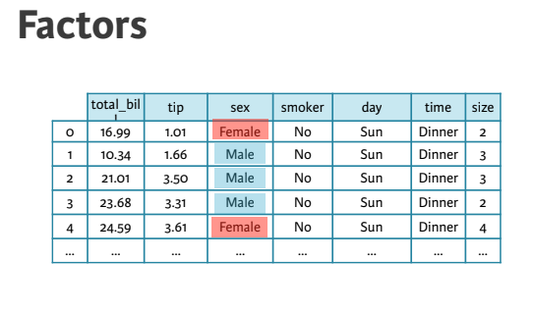
Seaborn (cont.)

Slide 12
Univariate Data Visualization
Strip plots :- A strip plot is a graphical data anlysis technique for summarizing a univariate data set.
Horizontal axis = the value of the response variable;
Verticalal axis = all values are set to 1.
Swarm plot:- As you have seen, a strip plot can be visually crowded even with jitter applied and smaller point sizes. An alternative is provided by the swarm plot ( sns.swarmplot() ), which is very similar but spreads out the points to avoid overlap and provides a better visual overview of the data.
Violin Plots :- A violin plot is a method of plotting numeric data. It is similar to a box plot with a rotated kernel density plot on each side.

Slide 13
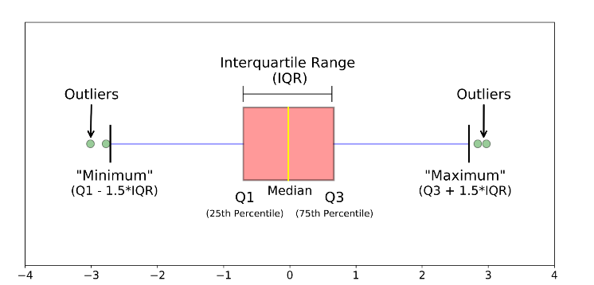
Box-Plot
A boxplot is a standardized way of displaying the distribution of data based on a five number summary (“minimum”, first quartile (Q1), median, third quartile (Q3), and “maximum”).

Slide 14
Multivariate Distribution Visualization
Visualizing relationships in multivariate data
Joint plot :- Displays a relationship between 2 variables (bivariate) as well as 1D profiles (univariate) in the margins.
Pairplot :- A pairs plot allows us to see both distribution of single variables and relationships between two variables. Pair plots are a great method to identify trends for follow-up analysis .
Heat-Map :- A heat map (or heatmap) is a graphical representation of data where the individual values contained in a matrix are represented as colors.

Slide 15


